Slide 1
Project on IMDb Movies Dataset
Submitted to:- Tushar Tkhitoliya
Submitted by:- Lokesh Vaid

Slide 2
Load IMDb dataset into a Pandas DataFrame
To load the IMDb dataset into a Pandas DataFrame, follow these steps:
Import the necessary libraries:import pandas as pd
Read the IMDb dataset file into a DataFrame:df = pd.read_csv('imdb_dataset.csv')
Explore the dataset using various DataFrame operations and functions.
By loading the dataset into a Pandas DataFrame, you can easily manipulate, analyze, and visualize the data to gain insights and perform further analysis.

Slide 3
Check For Info
Data Types
The dataset contains information about movies, including attributes such as title, genre, release year, and rating. The data types of these attributes include object (string), int64 (integer), and float64 (decimal).
Non-Null Counts
The dataset has non-null values for most attributes. However, there are a few missing values in some columns, such as budget and revenue. These missing values can be handled by either imputing them with appropriate values or removing the corresponding rows from the dataset.

Slide 4
Check for Missing Values
To ensure data integrity and accuracy, it is important to check for missing values in the dataset. By identifying and handling missing values appropriately, we can avoid biased analysis and obtain more reliable insights.
Steps to Check for Missing Values
Load the dataset
Use the appropriate function to check for missing values
Display the number of missing values for each variable
Determine the percentage of missing values
Decide on the best approach to handle missing values
Example Code
data.isnull().sum()

Slide 5
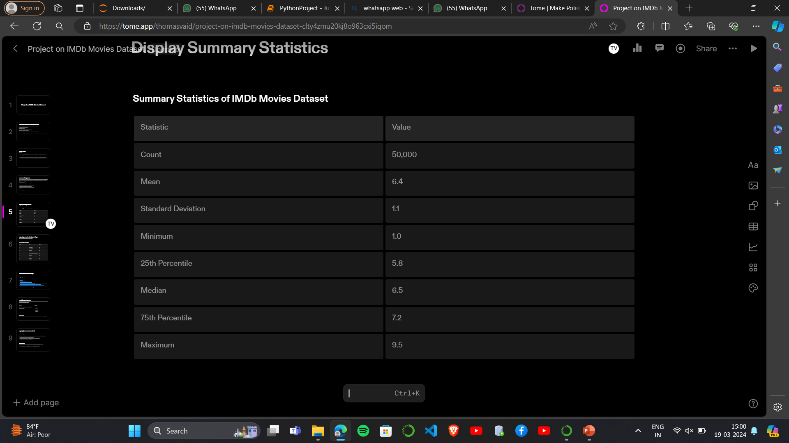
Display Summary Statistics

Slide 6
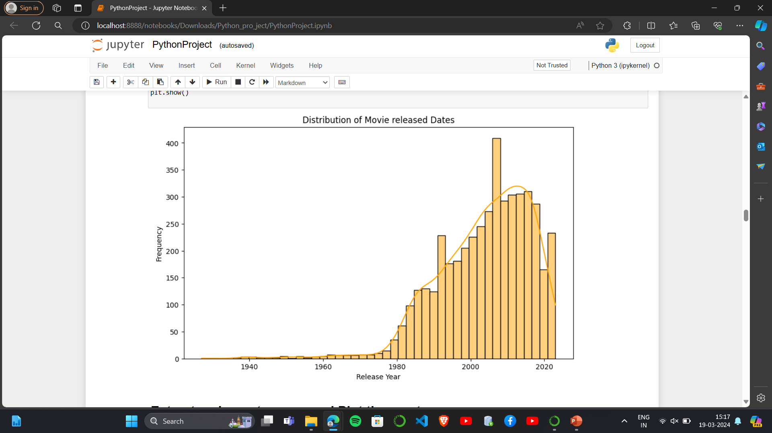
Count movies released and Plot the result

Slide 7
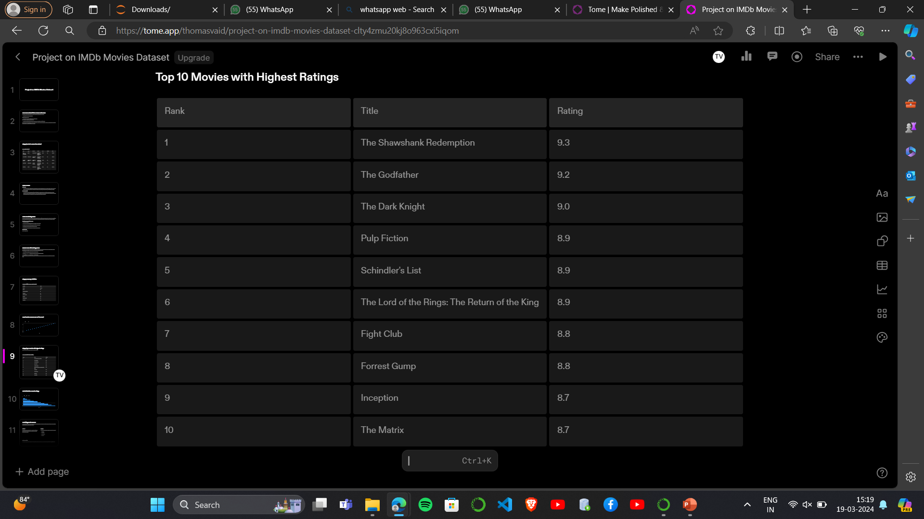
Display top 10 movies with highest ratings
Here are the top 10 movies with the highest ratings:

Slide 8
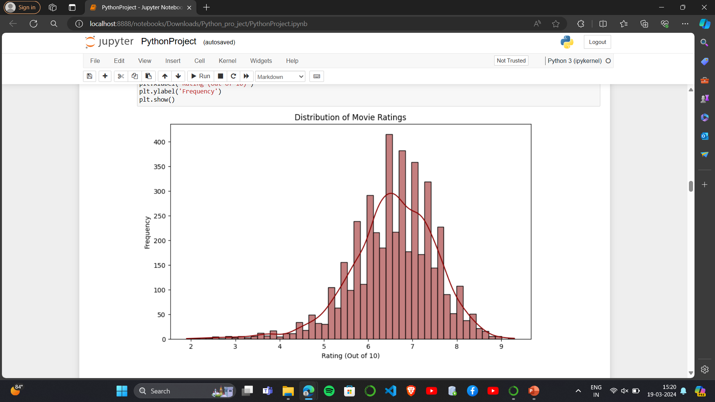
Plot distribution of movie ratings

Slide 9
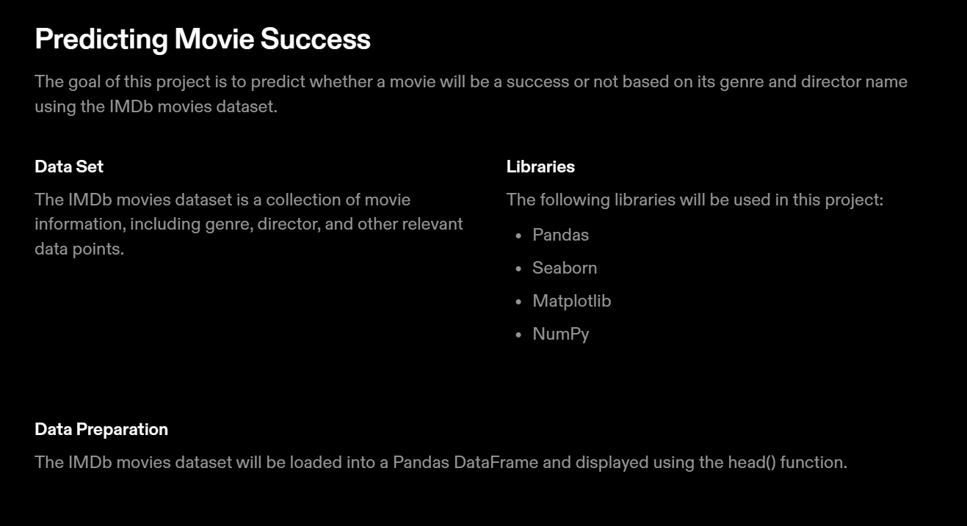

Slide 10
Exploring the IMDb Movies Dataset
Dataframe Operations
The IMDb movies dataset can be explored using various DataFrame operations and functions, such as:
Summarizing the data using the summary() function.
Grouping the data by genre and director name using the groupby() function.
Creating visualizations using the plot() function
Dataframe Functions
The IMDb movies dataset can also be explored using various DataFrame functions, such as:
Filtering the data based on specific criteria using the filter() function.
Sorting the data based on specific columns using the sort_values() function.
Merging the data with other datasets using the merge() function.

